Slide 1

Oracle11g:
PL/SQL Programming
Chapter 7
PL/SQL Packages

Slide 2
Chapter Objectives
After completing this lesson, you should be able to understand:
  Creating packages
  Invoking program units in packages
  Including a forward declaration
  Creating one-time-only procedures
  Overloading program units
  Managing restrictions on packaged functions used in SQL
Oracle11g: PL/SQL Programming

Slide 3
Chapter Objectives (continued)
After completing this lesson, you should be able to understand (continued):
  Using a cursor variable in a package
  Granting execute privileges
  Finding package information with data dictionary views
  Deleting or removing packages
Oracle11g: PL/SQL Programming

Slide 4
Packages
Containers that can hold multiple program units
Add functionality
  Private program units
  Sharing variable values
  Overloading
  Ease privilege granting
  Improve performance
Oracle11g: PL/SQL Programming

Slide 5
Brewbean’s Challenge
Organize the many program units developed for the application
Store values throughout a user session
Enable a program unit to handle different data types for arguments
Ease the granting of privileges to users
Oracle11g: PL/SQL Programming

Slide 6
Package Specification
Contains declarations for program units, variables, exceptions, cursors, and types
Declare program units with the header only
Order of declarations important if one construct refers to another in the specification
Oracle11g: PL/SQL Programming

Slide 7
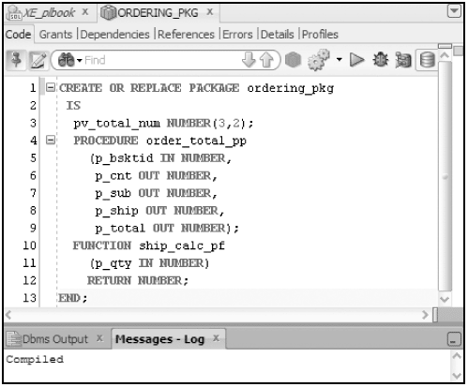
Package Specification (continued)
Oracle11g: PL/SQL Programming

Slide 8
Package Body
Contains the entire program unit code for those declared in the specification
Use program unit name in END statement to make more readable
Also can declare any new constructs not in the specification; however, these can only be used inside this package
Oracle11g: PL/SQL Programming

Slide 9
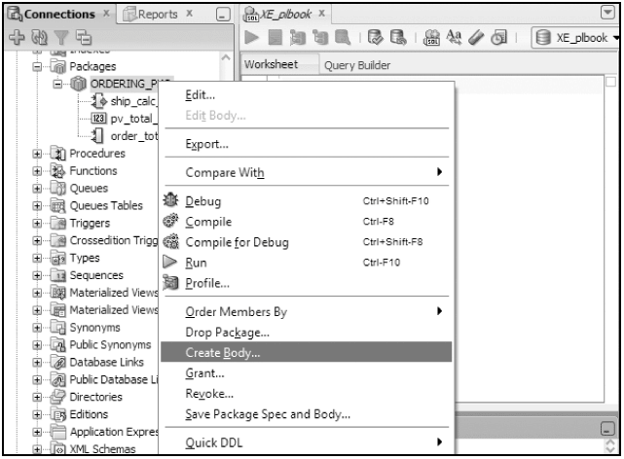
Package Body
Oracle11g: PL/SQL Programming

Slide 10
Invoking Package Constructs
Call packaged program units the same way as we handled stand-alone program units except add a package name prefix
package_name.program_unit_name(args,…);
Reference other packaged constructs such as a variable also using a package name prefix
package_name.variable_name
Oracle11g: PL/SQL Programming

Slide 11
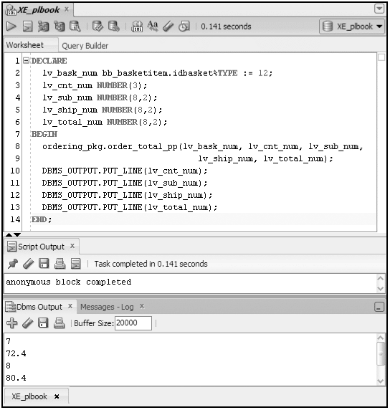
Invoking Package Constructs
Oracle11g: PL/SQL Programming

Slide 12
Package Construct Scope
Any constructs declared in the specification are public and can be referenced from inside or outside the package
Any constructs in the body only are private and can only be referenced by other constructs within the same package body
Oracle11g: PL/SQL Programming

Slide 13
Package Global Constructs
Constructs declared in the specification such as variables, cursors, types, and exceptions are global
Global means that the value will persist throughout a user session
Each user session maintains a separate instance of the packaged construct
Oracle11g: PL/SQL Programming

Slide 14
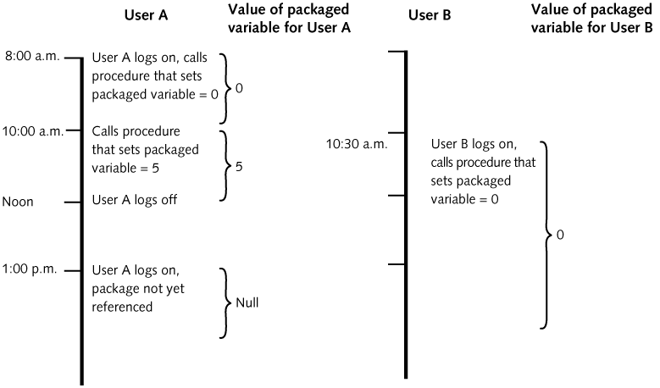
Package Global Constructs (continued)
Oracle11g: PL/SQL Programming

Slide 15
Package Specification
A specification can exist without a body
Used to store often referenced static values
Example
CREATE OR REPLACE PACKAGE metric_pkg IS
cup_to_liter CONSTANT NUMBER := .24;
pint_to_liter CONSTANT NUMBER := .47;
qrt_to_liter CONSTANT NUMBER := .95;
END;
Oracle11g: PL/SQL Programming

Slide 16
Improving Processing Efficiency
Packaged constructs such as variables and cursors are stored in memory
After the initial call, values can then be retrieved from cache in subsequent calls
Package code is also cached
Oracle11g: PL/SQL Programming

Slide 17
Forward Declarations
Private program units must be ordered so that any referenced unit is located prior to the calling program unit in the package body
You need a workaround if you want to organize program units in the body
Forward declarations eliminate the order problem
A forward declaration is the program unit header at the top of the package body
Oracle11g: PL/SQL Programming

Slide 18
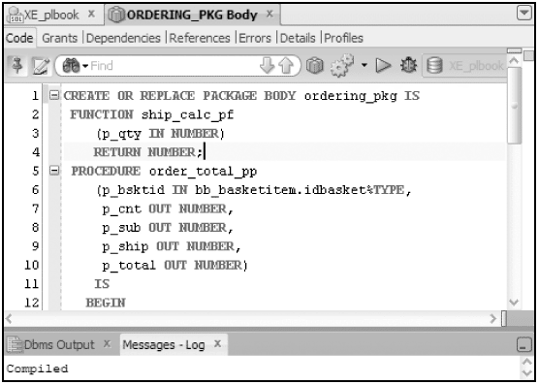
Forward Declarations
Oracle11g: PL/SQL Programming

Slide 19
One Time Only Procedure
Used when user needs a dynamic action to occur on the initial call to a package
It is an anonymous block placed at the end of a package body (no END statement!)
Only executes on initial call to the package
Typically used to populate global constructs
Oracle11g: PL/SQL Programming

Slide 20
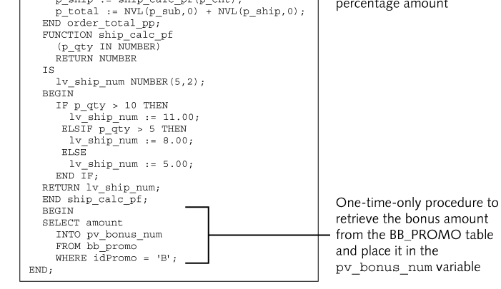
One Time Only Procedure
Oracle11g: PL/SQL Programming

Slide 21
Overloading Program Units
Overloading is the creation of more than one program unit with the same name
The program units must differ by at least one of the following:
  Number of parameters
  Parameter data type families
  Listed order
Oracle11g: PL/SQL Programming

Slide 22
Overloading Program Units (continued)
Allows a particular program unit to accept various sets of arguments
Some Oracle-supplied functions are overloaded, such as TO_CHAR, which can accept various data types as an argument
Overloading can only be accomplished with a package
Oracle11g: PL/SQL Programming

Slide 23
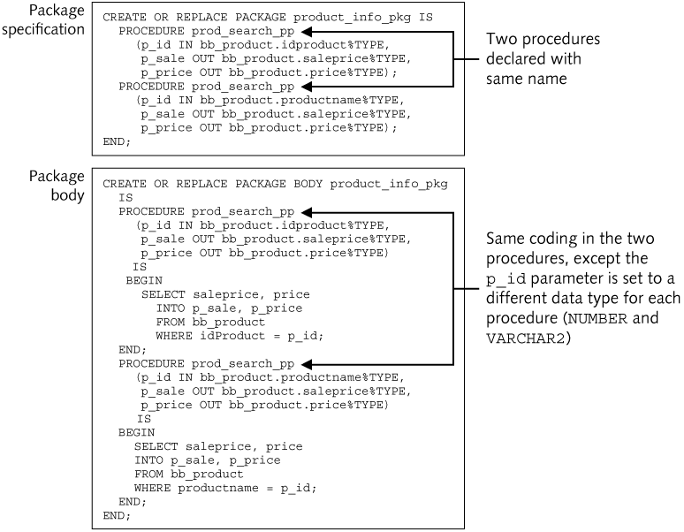
Overloading Program Units (continued)
Oracle11g: PL/SQL Programming

Slide 24
Packaged Function Restrictions
Function purity level defines what structures the function reads or modifies
Important to indicate purity level in package specification to discover errors at compile time rather than run time
Add the following statement in the specification:
PRAGMA RESTRICT_REFERENCES(program_unit_name, purity levels,…)
Oracle11g: PL/SQL Programming

Slide 25
Purity Levels
Level Acronym
Level Name
Level Description
WNDS
Writes No Database State
Function does not modify any database tables (No DML)
RNDS
Reads No Database State
Function does not read any tables (No select)
WNPS
Writes No Package State
Function does not modify any packaged variables (packaged variables are variables declared in a package specification)
RNPS
Reads No Package State
Function does not read any packaged variables
Oracle11g: PL/SQL Programming

Slide 26
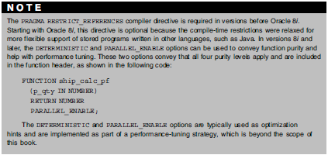
Purity Levels
Oracle11g: PL/SQL Programming

Slide 27
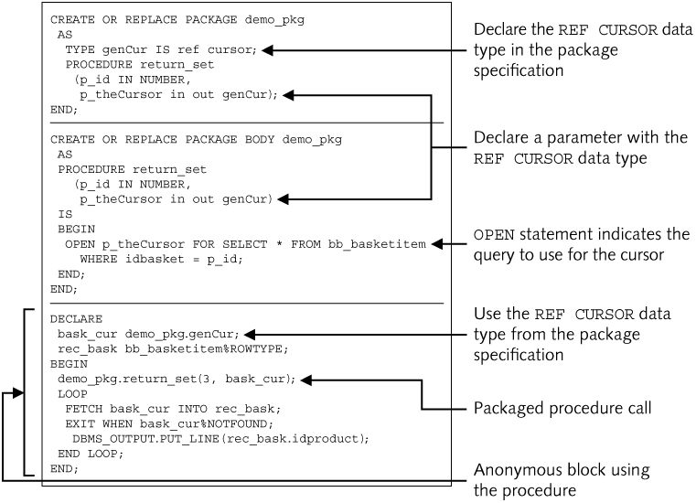
REF CURSOR Parameter
Oracle11g: PL/SQL Programming

Slide 28
Execute Privileges
Avoids issuing privileges to all database objects
If you issue EXECUTE privilege on a package, the user will assume the package owner rights for the period of execution
  Called definer-rights
You can override this default by adding AUTHID CURRENT_USER in the specification
Adds security by avoiding the direct access issue of privileges to database objects
Oracle11g: PL/SQL Programming

Slide 29
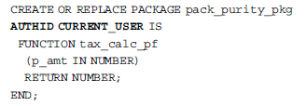
Execute Privileges
Oracle11g: PL/SQL Programming

Slide 30

Data Dictionary Information
Text column of USER_SOURCE view will display the source code of the entire package – specification and body
Use a WHERE clause on the name column to select only one package
The USER_OBJECTS view can be used to determine what packages exist in the database
Upper case
Oracle11g: PL/SQL Programming

Slide 31
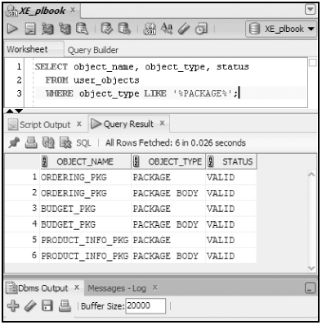
Data Dictionary Information
Oracle11g: PL/SQL Programming

Slide 32
Deleting Packages
To delete specification and body:
  DROP PACKAGE package_name;
To delete the body only:
  DROP PACKAGE BODY package_name;
Oracle11g: PL/SQL Programming

Slide 33
Summary
A package can have two parts: a specification and a body
Packages allow both public and private constructs
Global construct values persist
Forward declaration enables program unit organization
One time only procedures only execute on the initial call to the package
Oracle11g: PL/SQL Programming

Slide 34
Summary (continued)
Overloading allows program units to accept different sets of arguments
Address function purity levels
Granting the EXECUTE privilege on a package enables definer-rights
A REF CURSOR can pass a set of data between program units
The USER_SOURCE data dictionary view is used to retrieve package source code
The DROP statement is used to delete packages
Oracle11g: PL/SQL Programming

